Slide 1

Chapter 14
Strategies for Firm Growth
Bruce R. Barringer
R. Duane Ireland
14-<number>

Slide 2
Chapter Objectives
1 of 2
Explain the difference between internal growth strategies and external growth strategies.
Identify the keys to effective new product development.
Explain the common reasons new products fail.
Discuss a market penetration strategy.
Explain “international new venture” and describe its importance to entrepreneurial firms.
Discuss the objectives a company can achieve by acquiring another business.
14-<number>

Slide 3
Chapter Objectives
2 of 2
Identify a promising acquisition candidate’s characteristics.
Explain “licensing” and how it can be used as a growth strategy.
Explain “strategic alliances” and describe the difference between technological alliances and marketing alliances.
Explain “joint ventures,” and describe the difference between a scale joint venture and a link joint venture.
14-<number>

Slide 4
Internal and External Growth Strategies
1 of 2
Internal Growth Strategies
External Growth Strategies
Involve efforts taken within the firm itself, such as new product development, other product related strategies, and international expansion.
Rely on establishing relationships with third parties, such as mergers, acquisitions, strategic alliances, joint ventures, licensing, and franchising.
14-<number>

Slide 5
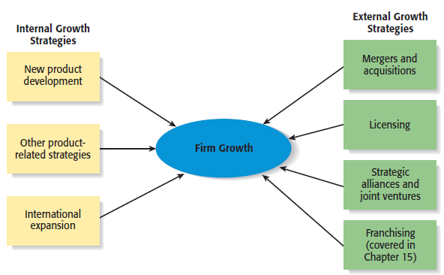
Internal and External Growth Strategies
2 of 2
14-<number>

Slide 6
Internal Growth Strategies
New product
development
Other product-
related strategies
International
expansion
14-<number>

Slide 7
Advantages and Disadvantages of Internal Growth Strategies
Advantages
Disadvantages
Incremental, even-paced growth.
Provides maximum control.
Preserves organizational culture.
Encourages internal entrepreneurship.
Allows firms to promote from within.
Slow form of growth.
Need to develop new resources.
Investment in a failed internal growth
strategy can be difficult to recoup.
Adds to industry capacity.
14-<number>

Slide 8
New Product Development
1 of 3
New Product Development
  Involves the creation and sale of new products (or services) as a means of increasing firm revenues.
  In many fast-paced industries, new product development is a competitive necessity.
    For example, the average product life cycle in the computer software industry is 14 to 16 months.
14-<number>

Slide 9
New Product Development
2 of 3
Keys to Effective New Product and Service Development
Find a niche and fill it.
Develop products that add value.
Get quality right and pricing right.
Focus on a specific target market.
Conduct ongoing feasibility analysis.
14-<number>

Slide 10
New Product Development
3 of 3
Common Reasons That New Products Fail
Inadequate feasibility analysis.
Overestimation of market potential.
Bad timing.
Inadequate advertising and promotions.
Poor service.
14-<number>

Slide 11
Other Product Related Strategies
1 of 2
Product Strategy
Description
Improving an Existing Product or Service
Often a business can increase its revenues by simply increasing the quality of an existing product or service.
Increasing Market Penetration
Increasing the sales of a product or service through greater marketing efforts or through increased production capacity.
4-<number>

Slide 12
Other Product Related Strategies
2 of 2
Product Strategy
Description
Extending Product Lines
Making additional variations of a product so it will appeal to a broader range of clientele.
Geographic Expansion
Growth via expanding to additional geographic locations .
4-<number>

Slide 13
International Expansion
1 of 3
International Expansion
  Another common form of growth for entrepreneurial firms.
  International new ventures are businesses that, from their inception, seek to derive significant competitive advantage by using their resources to sell products or services in multiple countries.
  Although there is vast potential associated with selling overseas, it is a fairly complex form of growth.
14-<number>

Slide 14
International Expansion
2 of 3
Foreign-Market Entry Strategies
  Exporting
    Producing a product at home and shipping it to a foreign market.
  Licensing
    An arrangement whereby a firm with the proprietary rights to a product grants permission to another firm to manufacture that product for specified royalties or other payments.
  Joint Ventures
    Involves the establishment of a firm that is jointly owned by two or more otherwise independent firms.
      Fuji-Xerox is a joint venture between an American and a Japanese company.
14-<number>

Slide 15
International Expansion
3 of 3
Foreign-Market Entry Strategies
  Franchising
    An agreement between a franchisor (a company like McDonald’s Inc., that has an established business method and brand) and a franchisee (the owner of one or more McDonald’s restaurants).
  Turnkey Project
    A contractor from one country builds a facility in another country, trains the personnel that will operate the facility, and turns over the keys to the project when it is completed and ready to operate.
  Wholly Owned Subsidiary
    A company that has made the decision to manufacture a product in a foreign country and establish a permanent presence.
14-<number>

Slide 16
External Growth Strategies
Mergers and
Acquisitions
Licensing
Strategic Alliances
and Joint Ventures
Franchising
(Chapter 15)
14-<number>

Slide 17
Advantages and Disadvantages of External Growth Strategies
Advantages
Disadvantages
Reducing competition.
Access to proprietary products.
Gaining access to new products.
Gaining access to new markets.
Access to technical expertise.
Access to an established brand name.
Economies of scale.
Diversification of business risk.
Incompatibility of top management.
Clash of corporate cultures.
Operational problems.
Increased business complexity.
Loss of organizational flexibility.
Antitrust implications.
14-<number>

Slide 18
Mergers and Acquisitions
Mergers and Acquisitions
  An acquisition is the outright purchase of one firm by another .
  A merger is the pooling of interests to combine two or more firms into one.
Purpose of Acquisitions
  Acquiring another business can fulfill several of a company’s needs, such as:
    Expanding its product line.
    Gaining access to distribution channels.
    Achieving competitive economies of scale.
14-<number>

Slide 19
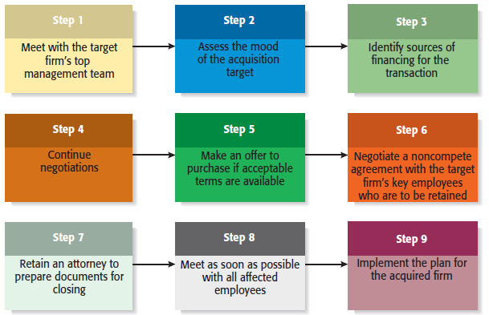
The Process of Competing an Acquisition
14-<number>

Slide 20
Licensing
1 of 3
Licensing
  The granting of permission by one company to another company to use a specific form of its intellectual property under clearly defined conditions.
  Virtually any intellectual property a company owns that is protected by a patent, trademark, or copyright can be licensed to a third party.
Licensing Agreement
  The terms of a license are spelled out by a licensing agreement.
14-<number>

Slide 21
Licensing
2 of 3
Type of Licensing
Description
Technology Licensing
The licensing of proprietary technology that the licensor typically controls by virtue of a utility patent.
Merchandise and Character Licensing
The licensing of a recognized trademark or brand that the licensor typically controls through a trademark or copyright.
4-<number>

Slide 22

Licensing
3 of 3
Character licensing, for example,
represented a major source of
revenue for Pixar in its early
years.
Popular characters, like Marlin
and Dory from Finding Nemo,
adorn products as diverse as
dinner plates and sleeping bags.
4-<number>

Slide 23
Strategic Alliances
1 of 2
Strategic Alliances
  A strategic alliance is a partnership between two or more firms developed to achieve a specific goal.
  Strategic alliances tend to be informal and do not involve the creation of a new entity.
  Participating in strategic alliances can boost a firm’s rate of product innovation and foreign sales.
14-<number>

Slide 24
Strategic Alliances
2 of 2
Type of Alliance
Description
Technological Alliances
Feature cooperation in R&D, engineering, and manufacturing.
Marketing Alliances
Typically match a company with excess distribution capacity with a company that has a product to sell.
4-<number>

Slide 25
Joint Ventures
1 of 2
Joint Ventures
  A joint venture is an entity created when two or more firms pool a portion of their resources to create a separate, jointly owned organization.
  A common reason to form a joint venture is to gain access to a foreign market. In these cases, the joint venture typically consists of the firm trying to reach a foreign market and one or more local partners.
14-<number>

Slide 26
Joint Ventures
2 of 2
Type of Joint Venture
Description
Partners collaborate at a single point in the value chain to gain economies of scale in production or distribution.
Scale Joint Venture
Positions of the partners are not symmetrical, and the partners help each other access adjacent links in the value chain.
Link Joint Venture
4-<number>

Slide 27
Advantages and Disadvantages of Participating in Strategic Alliances and Joint Ventures
Advantages
Disadvantages
Gain access to a specific resource.
Economies of scale.
Risk and cost sharing.
Gain access to a foreign market.
Learning.
Speed to market.
Neutralizing competitors.
Blocking competitors.
Loss of proprietary information.
Management complexities.
Financial and organizational risks.
Risk becoming depending on a partner.
Partial loss of decision autonomy.
Partners’ cultures may clash.
Loss of organizational flexibility.
14-<number>

Slide 28


All rights reserved. No part of this publication may be reproduced, stored in a retrieval system, or transmitted, in any form or by any means, electronic, mechanical, photocopying, recording, or otherwise, without the prior written permission of the publisher. Printed in the United States of America.
Copyright ©2010 Pearson Education, Inc.

